Slide 1

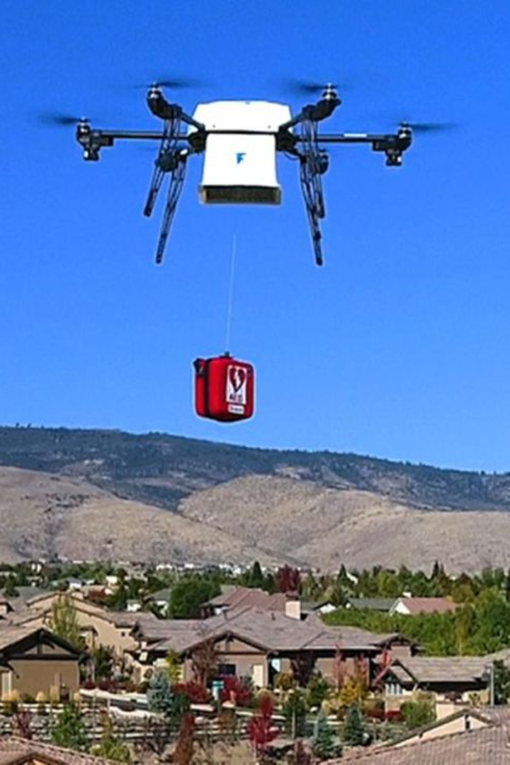


Introduction to Drone Delivery System for Medical Supplies using machine learning
Drone delivery systems offer a revolutionary way to transport medical supplies to remote and war-hit regions, overcoming traditional logistical challenges.
by bhavik sharma

Slide 2
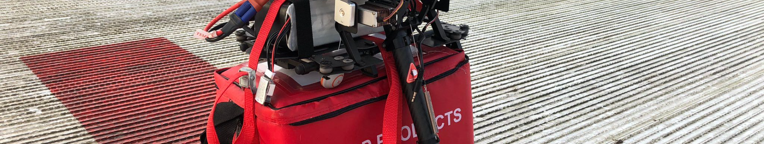
Importance of Delivering Medical Supplies to Remote and War-Hit Regions
1
Lifesaving Impact
2
Access to Healthcare
Timely supply of medical supplies can save lives in critical situations.
Enables access to healthcare in areas with limited infrastructure.

Slide 3
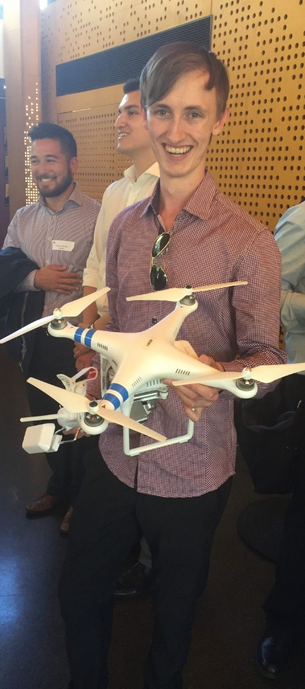
Technical Challenges in Implementing a Drone Delivery System and in the further slides their solutions -
1
Range and Payload
2
Navigation
Addressing limitations on distance and weight carrying capacity.
Developing precise GPS navigation to reach remote locations.

Slide 4
Drone delivery requires an advanced fleet management software like FlytBase that helps plan & execute long-range EVLOS/BVLOS flights with live tracking and drone control over 4G/LTE/5G.FlytBase Delivery is a cloud-based offering that can be used for package delivery operations.
In our application we will be using the FlytBase software for software unification
Webiste for flytbase -https://www.flytbase.com/

Slide 5
Our drones will not be completely human controlled instead they will be trained on machine learning algorithms to more accurately pinpoint the location of the next person in the area
This is because –
1. Machine learning can identify patterns that are too complex for humans to observe
2. Machine learning can make predictions based on a much larger data set than traditional methods.
3. Machine learning is not as biased by human emotions or subjective opinions.
4. Machine learning can adapt to changes quickly
5. Machine learning is more accessible than traditional methods
Further explanation of the above mentioned points in the upcoming slides -

Slide 6
The drones will not be completely human controlled because - Machine learning can identify patterns that are too complex for humans to observe.One of the key advantages of machine learning is that it can identify patterns that are too complex for humans to observe. Traditional methods of forecasting are limited by the amount of data that can be processed and analyzed by humans.For example, suppose we wanted to forecast stock market prices. Traditional methods would rely on analysts to identify patterns in the market and make predictions based on research. However, it is often difficult for humans to identify all of the factors that influence stock prices. Machine learning can analyze large amounts of data very quickly and identify patterns that are not visible to humans. This can lead to more accurate predictions than traditional methods.Renaissance Technologies has used machine learning to great effect in this area. The company has developed machine learning algorithms that have achieved over 70% annualized returns since its inception in 1994.2. Machine learning can make predictions based on a much larger data set than traditional methods.Machine learning can also make predictions based on a much larger data set than traditional methods.Consider the problem of forecasting sales. A traditional method such as trend analysis might only consider past sales data in order to make a forecast. Machine learning, on the other hand, can analyze data from social media, customer reviews, and other sources in order to make a more accurate prediction.In addition to time series data, machine learning models can factor in supply chain data and other real-world metrics, enabling greater demand forecasting accuracy. Traditional time series forecasting falls short when it comes to big data.3. Machine learning is not as biased by human emotions or subjective opinions.One of the biggest disadvantages of traditional methods of forecasting is that they are biased by human emotions and subjective opinions. This can lead to inaccurate predictions, as humans are often swayed by their personal biases and emotions. Machine learning is not as biased by human emotions or subjective opinions, which leads to more accurate predictions.Consider the example of a company that is considering opening a new store. Traditional methods of forecasting might be biased by the personal biases of the people doing the forecasting. For example, they may be more likely to predict that the store will be successful if they are personally invested in it, regardless of the evidence. Machine learning, on the other hand, would not be swayed by these personal biases and would make more accurate predictions.Of course, ML models can be biased as well, if the data used to train the models has bias. However, after ensuring that you’re using unbiased data, you can rely on cross-validation to inform you if the model you’re building is accurate.4. Machine learning can adapt to changes quicklyMachine learning can also adapt to changes in the data set, whereas traditional methods can become less accurate over time. As the data set changes, machine learning will adapt its predictions accordingly. This ensures that the predictions are always accurate and up-to-date. Traditional methods, on the other hand, can become less accurate over time as the data set changes.For instance, let's say you have a data set that consists of customer purchase data. As time goes on, the customers in this data set may change. The traditional approach would be to rebuild the forecast with the new data set, which would then produce new predictions. However, if you use machine learning, the model can automatically adapt to the new data set.5. Machine learning is not as easily manipulated as traditional methods.Machine learning is also less easily manipulated than traditional methods. As machine learning relies on algorithms to make predictions, it is much more difficult to manipulate the predictions than it is to manipulate the predictions made by traditional methods. This leads to more accurate predictions.6. Machine learning is a more efficient use of resourcesMachine learning is a more efficient use of resources than traditional methods. Traditional methods often require a lot of manual work, which can be time-consuming and expensive. The modern executive understands that to remain competitive, they need to focus on leveraging technology for competitive advantage. Machine learning can automate the process of making predictions, which is a more efficient use of resources.7. Machine learning is more accessible than traditional methodsMachine learning is also more accessible than traditional methods. Traditional methods often require specialized knowledge and training. Machine learning, on the other hand, is becoming more accessible as the technology advances. There are now many software platforms that allow anyone to build machine learning models without any prior knowledge or experience.

Slide 7
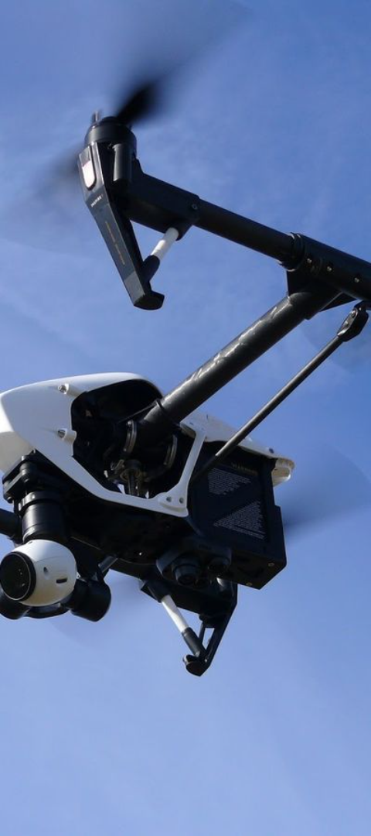


Regulatory and Legal Challenges in Implementing a Drone Delivery System
Flight Permissions
Obtaining clearance for aerial operations in restricted airspace
.
Compliance
Adhering to aviation regulations and safety standards.

Slide 8
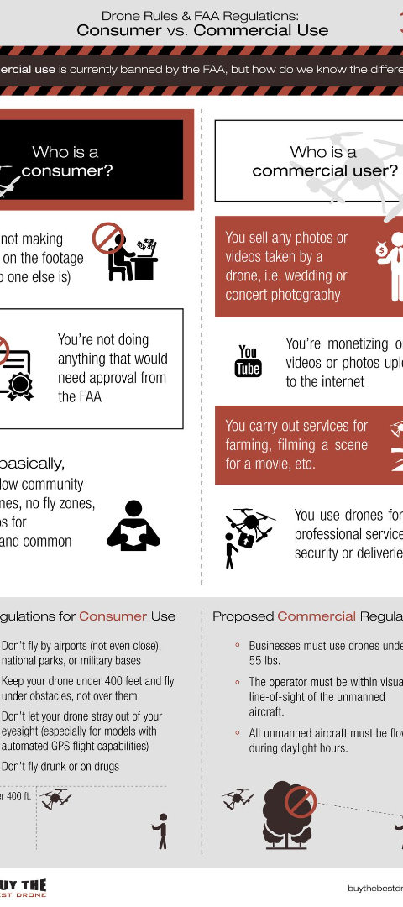
Safety and Security Considerations for Drone Delivery in Sensitive Areas
Geofencing
Data Encryption
Implementing geofencing technologies for no-fly zone enforcement.
Ensuring secure transmission and delivery of sensitive medical data.

Slide 9
Whether you are flying in rural or suburban areas, the safety of people on the ground and expensive drone equipment is of utmost importance. Emergency situations like flight system failure, bad weather conditions, or immediate advisory from the local aviation authorities may happen anytime.In addition to standard drone fail-safes (RTH, Geofence, etc.), FlytBase provides Emergency Landing Point (ELP) Failsafes.‍ELP Failsafes allow you to define landing points along your delivery route and land the drone on the nearest ELP when a situation arises.FlytBase also provides advanced geofence features to draw a polygon on a map along the delivery route to restrict drones from going outside the designated area.In unavoidable situations, a safety parachute on the drone can avoid accidents. Here are some of the brands which we will be reffering to for drone safety-
parachutes:
IndemnisParaZero
VectorSave

Slide 10
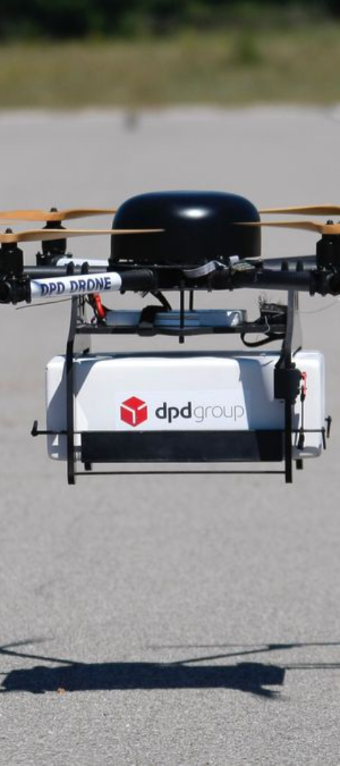
Case Studies of Successful Drone Delivery Systems in Remote and War-Hit Regions
1
Rwanda's Medical Drone Delivery
Established efficient emergency medical deliveries to remote locations.
2
Afghanistan's Blood Delivery System
Improved blood transfusion services in challenging terrains.

Slide 11


Future Prospects and Potential Advancements in Drone Delivery Technology
Technological Innovations
Global Adoption
Advancements in drone capabilities for enhanced range and precision.
Increased integration of drone technology in healthcare supply chains globally.

Slide 12
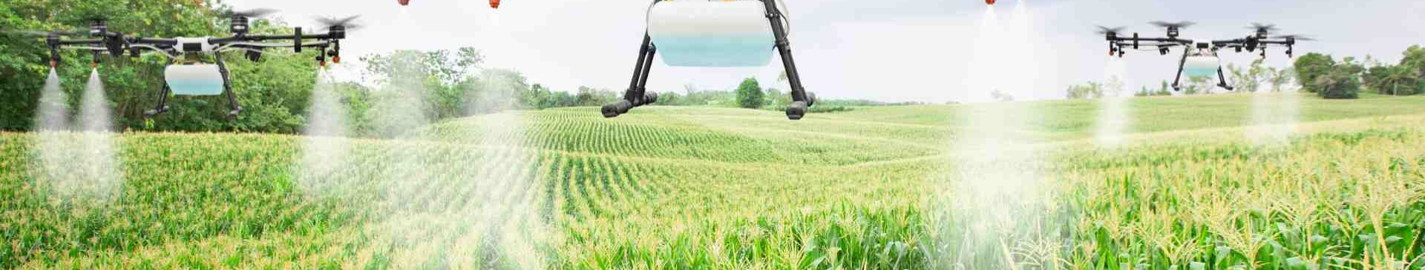
Conclusion
Drone delivery systems present a promising avenue to revolutionize medical supply chains, offering a lifeline to remote and war-hit regions. Overcoming challenges through innovation is vital for achieving widespread success in this field.

